Slide 1


Taku dating simulator
Part one
aku begins
An interactive experience

Slide 2
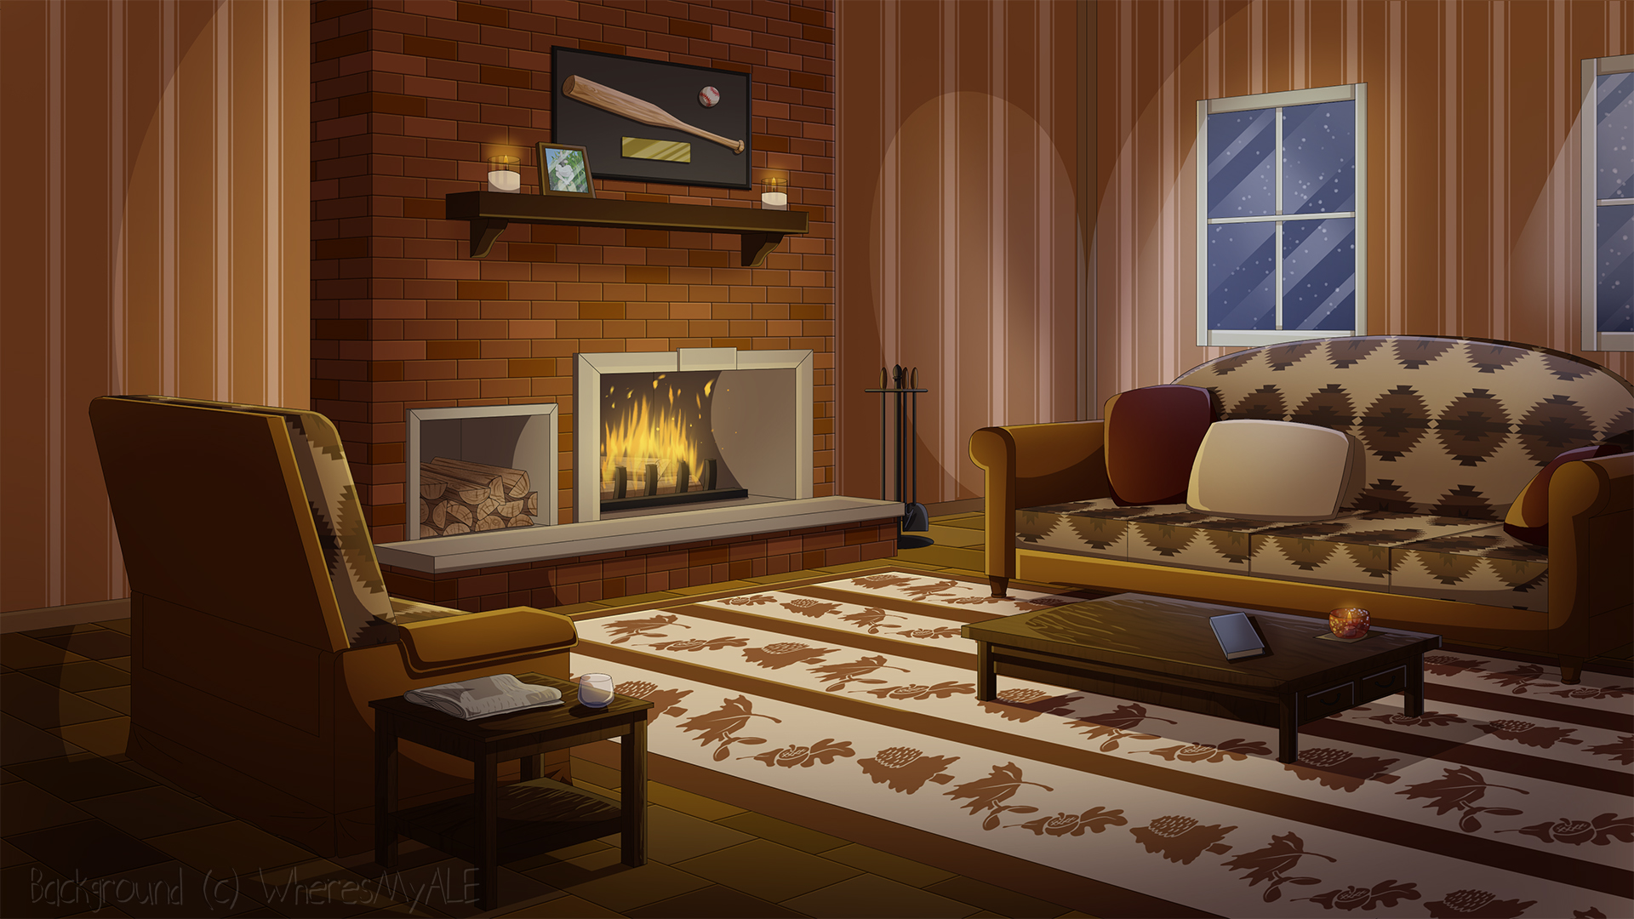

The beginning of a Journey
Comic-con date
Coffee shop date
The incident
( ͡° ͜ʖ ͡°)
School

Slide 3
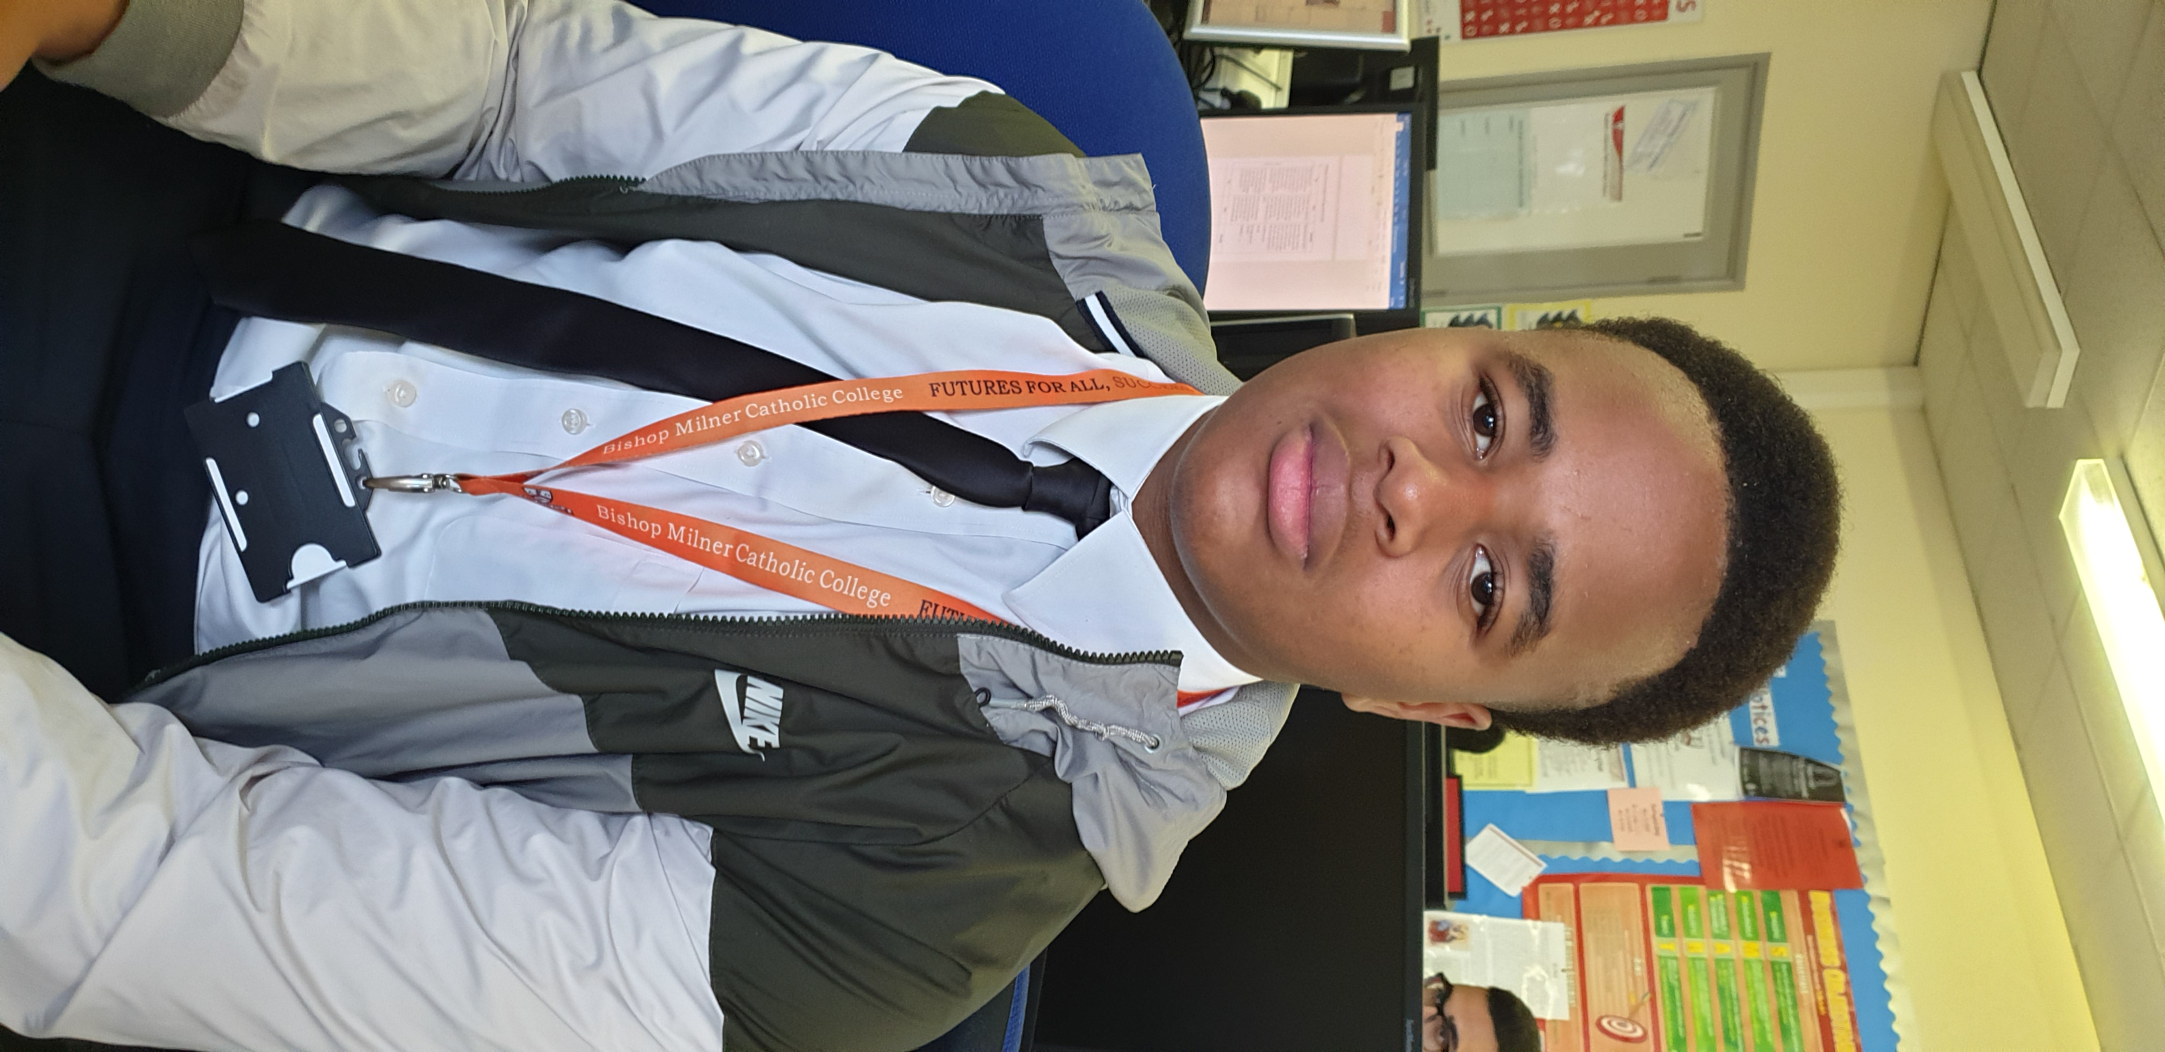
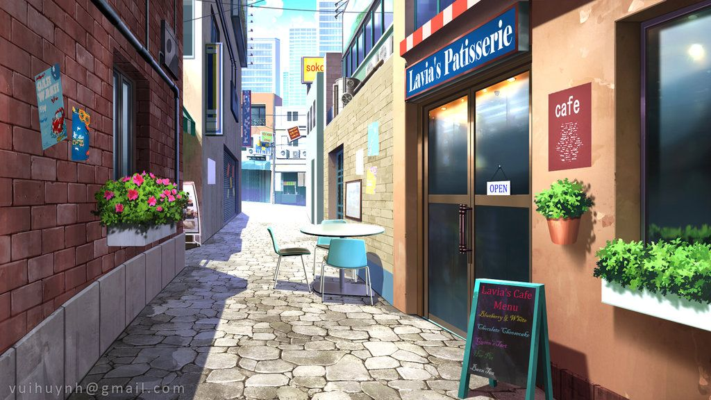
You’re walking down the street, but then you accidentally drop your phone. When you reach down to pick it up, you can’t find it. Confused, you get back up and turn around to get a better look but all you see is him.
Ay yo big man
“Uhh” *blushes*
You are lost for words, but before you could muster up a sentence he says..
What do you say?
OwO
What you doin round my ends fam
…

Slide 4

Taku only deserves the best.
Just because she has a pretty face, doesn’t mean she has a pretty heart.
RESTART

Slide 5
A-Arigato >w<
“You seem to have dropped your phone” he says with a gentle yet powerful voice. His hand outstretches, gripping your phone firmly so he wouldn’t make the same mistake you did. As you go to take the phone, your fingertips grace the palm of his hand which felt like melted Nutella.
Who are you
What were you doing with my phone creep? Were you gonna steal it? Get away from me.

Slide 6
“I’m taku, nice to meet you fam” he replies. “Be careful next time, some mans out there would’ve taken it and dipped” he advised. While he turned around, you felt like you owed this man so much more so you exclaimed:
W-Wait!
(Never mind I’m too nervous ಥoಥ)
Can I have your number at least?

Slide 7
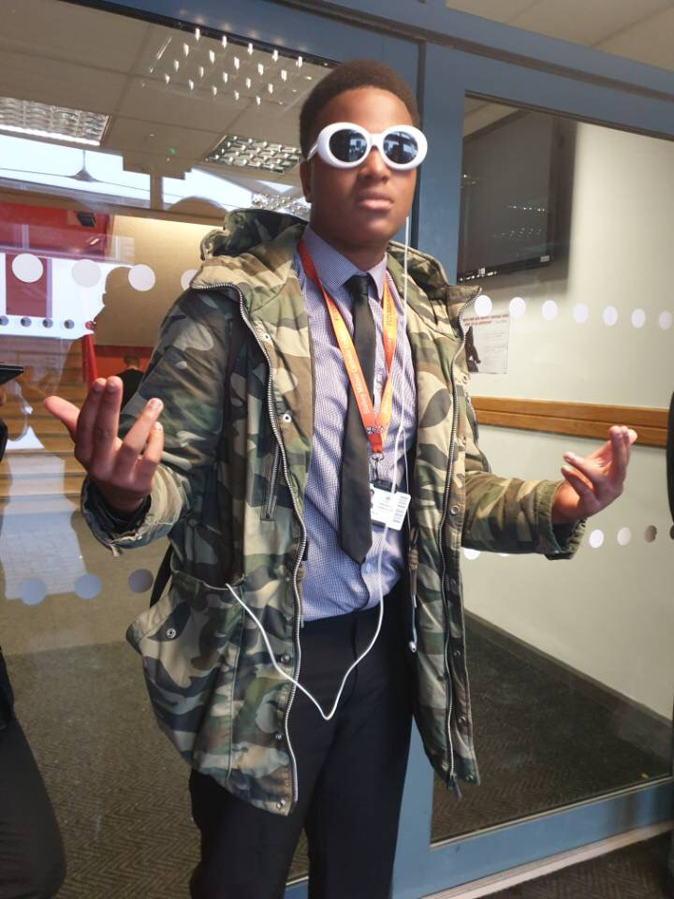
U failed to seduce this hunk of meat
Try again

Slide 8
“You look like a nice person fam, I’d bus u my number but I only have my trap phone on me, but I like to take chances, would you like to go have some coffee tomorrow?”
BET
*Faints*
I sure will ;)

Slide 9
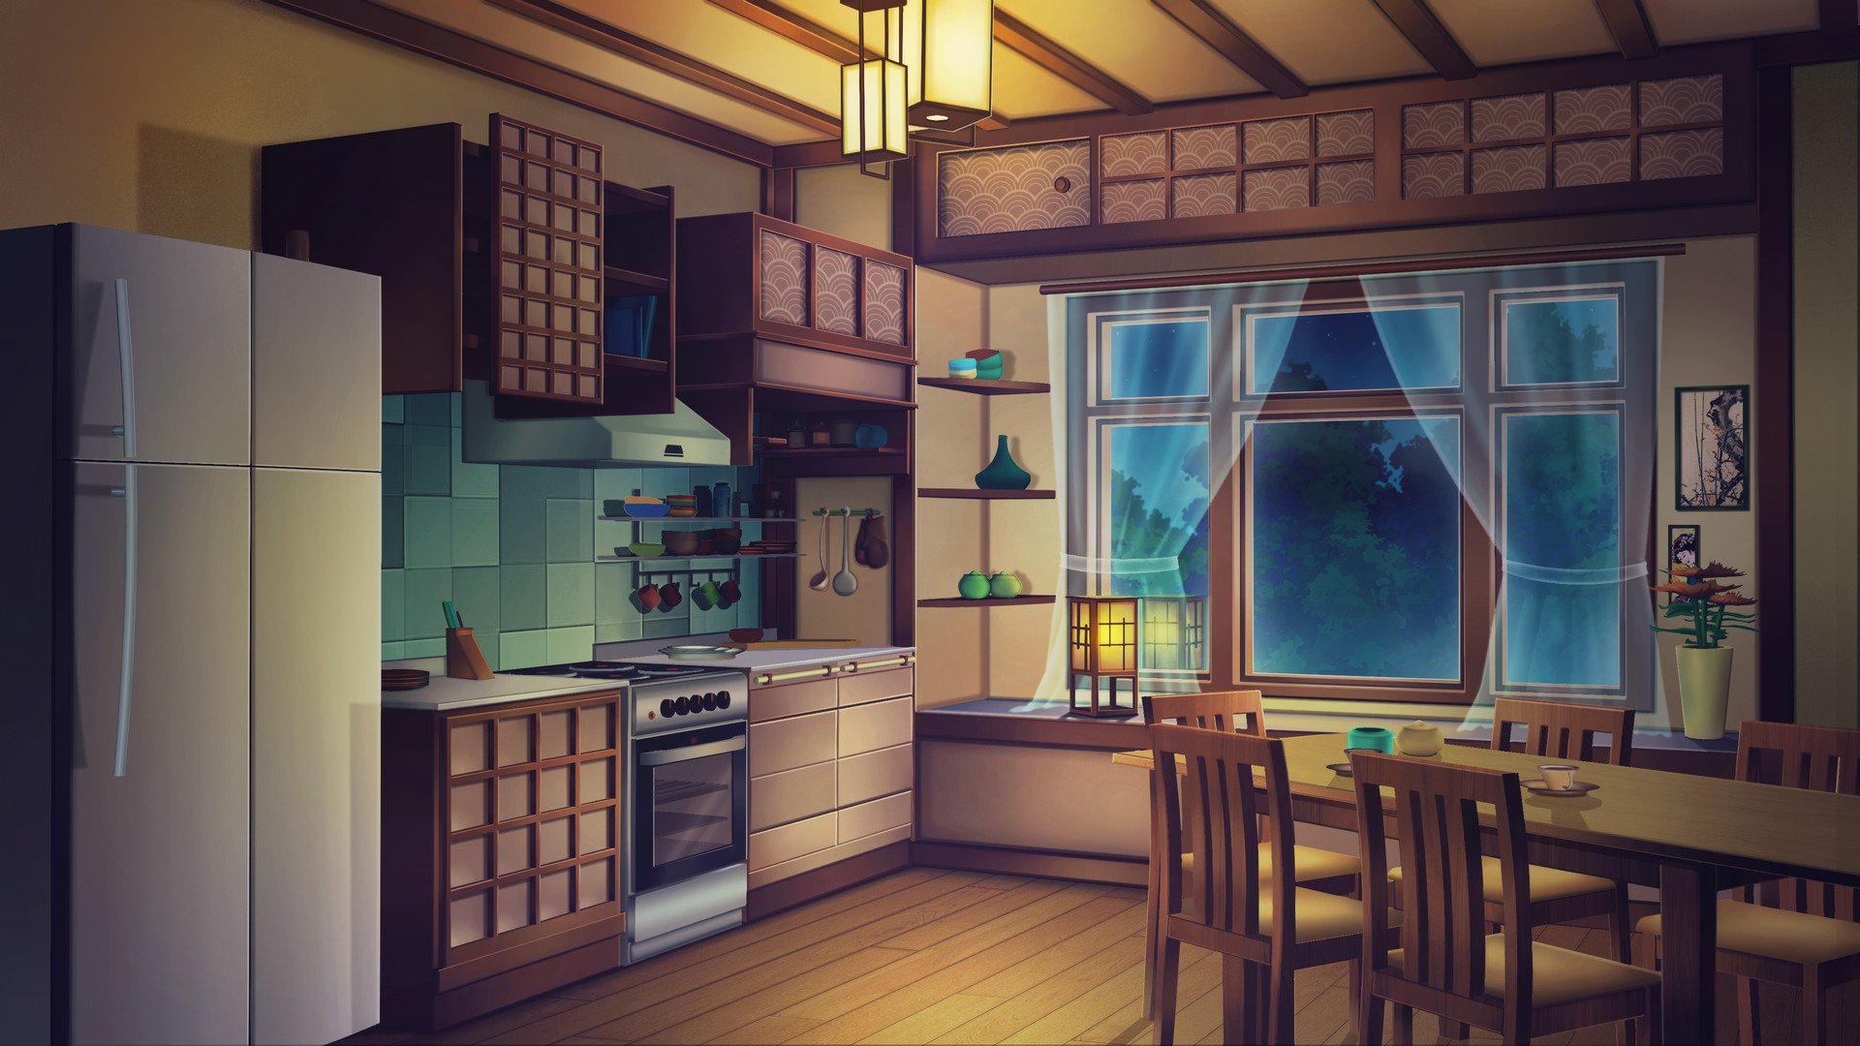
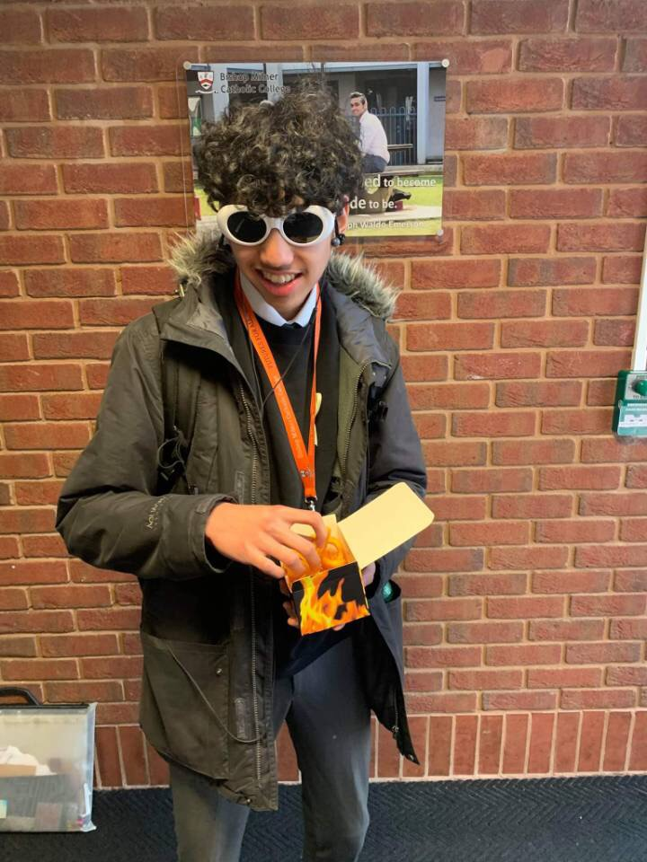
You rush back home with a small skip in your step. “I cant wait for tomorrow!” you exclaim to yourself while having a wide grin across your face. After reaching home you open your door and are greeted by your little brother.
H-H-H… Hell-oo, H-Howas your d-daay
With other things on your mind, you ignore your little brother, yet he doesn’t seem too bothered since it happens most of the time.
You run up to your room, jump onto your bed and exhale a breath of excitement.
Impossible to take Taku off your mind, you lay on your bed, staring at the ceiling thinking about what the next day holds.

Slide 10

The next day…

Slide 11
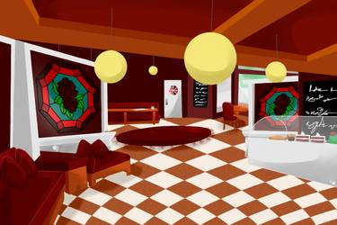
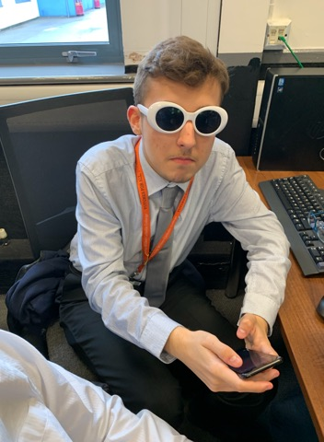
Not even having a wink of sleep, you jump out of your bed, grab your best looking clothes and head out. You pass your little brother who’s been staring at an off screen TV for probably hours whilst mumbling gibberish under his breath. You burst through the doors and start speed walking towards the local Costabucks coffee. Once you enter you start looking for Taku, but you can’t seem to locate him. Accidentally, you catch eyes with a shady looking man at the back who smiles and says:
Warg1 peng ting gimme ur digits
What do you do?
Ignore and carry on looking for Taku
Wink back and slide him your number
Sit down with him and share a cup of coffee

Slide 12
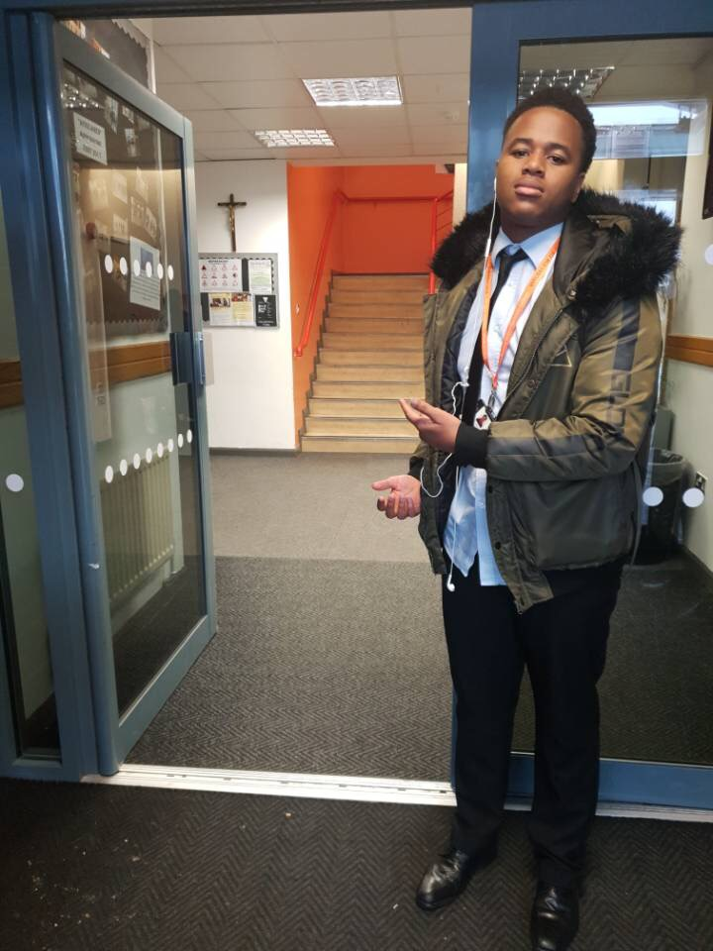
How can Taku trust you if your just going to talk to an equally hot guy on a date your supposed to be on with HIM
TRY AGAIN

Slide 13
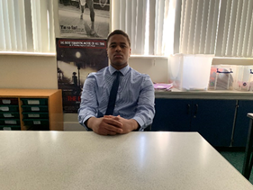

After searching for a while, your eyes are finally blessed with the presence of the man himself, Taku. You quickly walk over to him, but before you reach for the chair he pulls it out for you like the true gentleman he is. Both of you sit and exchange greetings and start small talk.
He asks if the guy who asked for your number earlier bothered you, but you shook your head and moved swiftly on to the next topic.

Slide 14
Date #1 : Blessed Brunch

Slide 15
How to play:
Choose all the choices you think make Taku like you even more.
Correct answers will fill up your progress bar however wrong answers will cause the bar to empty. Taku is a man of high expectations after all.
PROGRESS

Slide 16
You wanna help me power up my rasengan?
YES
PROGRESS
NO

Slide 17
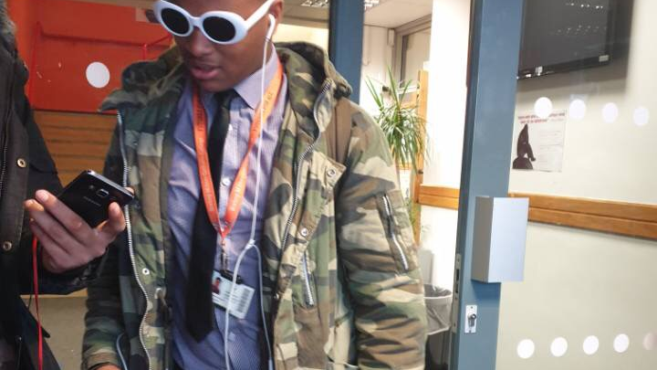
He can’t even look at you…
Try again, do it for him
TRY AGAIN

Slide 18
If mans ran you down, what would you do?
PULL OUT YOUR BELT AND CHASE THEM MANS UP
PROGRESS
RUN FAM
25%

Slide 19
Do you kiss your homies goodnight?
YES
PROGRESS
NO
50%

Slide 20
Bruh
Bruh
TRY AGAIN

Slide 21
Does Mike Wazowski blink or wink?
Blink
PROGRESS
Wink
75%

Slide 22
What colour are my eyes?
Those brown eyes are a million hues, so I wonder what the word "brown" even means. They are the forest and the autumnal leaves, the soil in summer and after the rains. How could we ever reduce something so spellbinding to one word, when the colours invite us to marvel in their simplicity.
PROGRESS
Brown
100%

Slide 23

You seem like a cool person fam. U wanna come comic con tomorrow with me?
Yoshaa sempai UwU
Weeb…
Another date?!?With you?!?YES SIR (SQUEEE!)

Slide 24
TRY AGAIN
You were literally in the home stretch man what happened?
Get back in there and fight for his love.

Slide 25
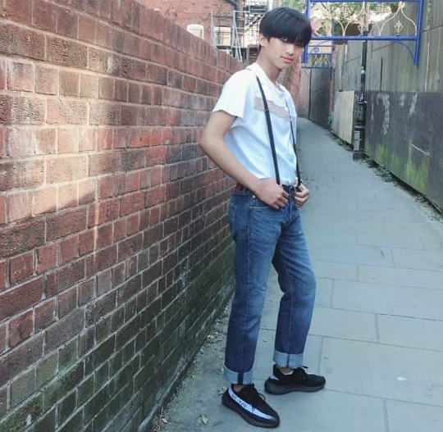
Whilst you walk home thinking about what costume your going to wear to your next big date, you run into an old school friend who’s name has seemed to escape your mind.
( ͡° ͜ʖ ͡ – ✧)
Ignore since Taku is your one and only.
His whole aura screams kawaii to the point that you coudn’t take your eyes off him
He smiles at you, what do you do?
( ͡~ ͜ʖ ͡°)
“Who are you again?”

Slide 26
✺◟( ͡° ͜ʖ ͡°)◞✺
“Should I call 999?”
You don’t understand how he’s saying these facial expressions but your too entranced to leave
Your starting to get worried since this doesn’t seem human. What next?
( ͡~ ͜ʖ ͡°)
“Bruh cmon who are you”

Slide 27
( ͡◉ ͜ʖ ͡◉)
Run
30 seconds have passed and he still hasn’t blinked or said anything, you realise you only have one option
His stare becomes more intense and filled with passion. You feel the adrenaline effect kick in and your muscles start to tense up
Run
Run

Slide 28
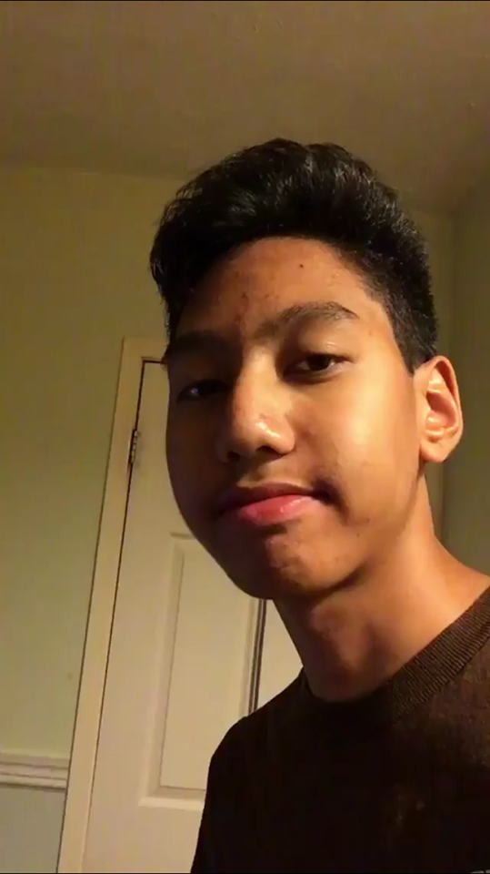
Fearing for your life, you run as fast as you can all the way home, quite literally bursting through the doors.
Your little brother stares at you with a blank expression but you push him aside as you collapse onto the sofa trying to calm down after that intense run in with that mysterious man. You hear your little brother mumble nonsense under his breath and make random noises upstairs as you try to calm your mind and prepare for the next day

Slide 29
The next day…

Slide 30
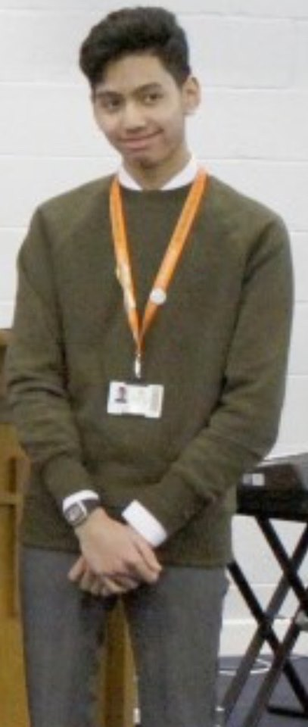
Wiping the sand out of your eyes, you rise up of the sofa after your long night to see your dad standing with your little brother. For some reason, he’s dressed up all nice like hes going somewhere
“Clink said you are going to comic con today, do you mind taking him?” your Father asked
You audibly groaned since this child is going to be the third wheel for the whole date, but u eventually agreed, which made your little brother’s face light up

Slide 31
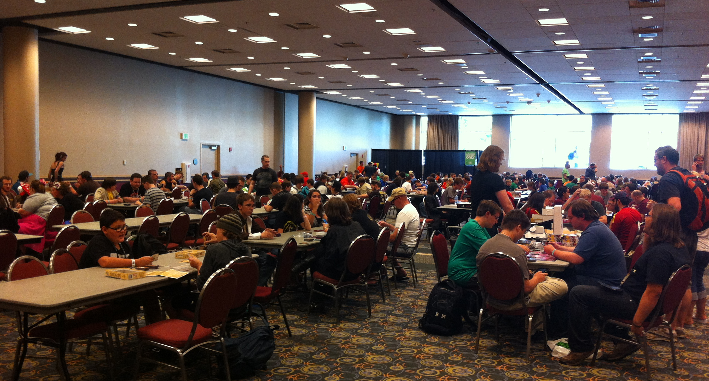
You finally reach the comic con centre, and start looking for your main attraction, Taku
For some reason, you have a bad feeling about today, since things usually are not that easy. You take a deep breath, and then enter the maze of neckbeards.

Slide 32
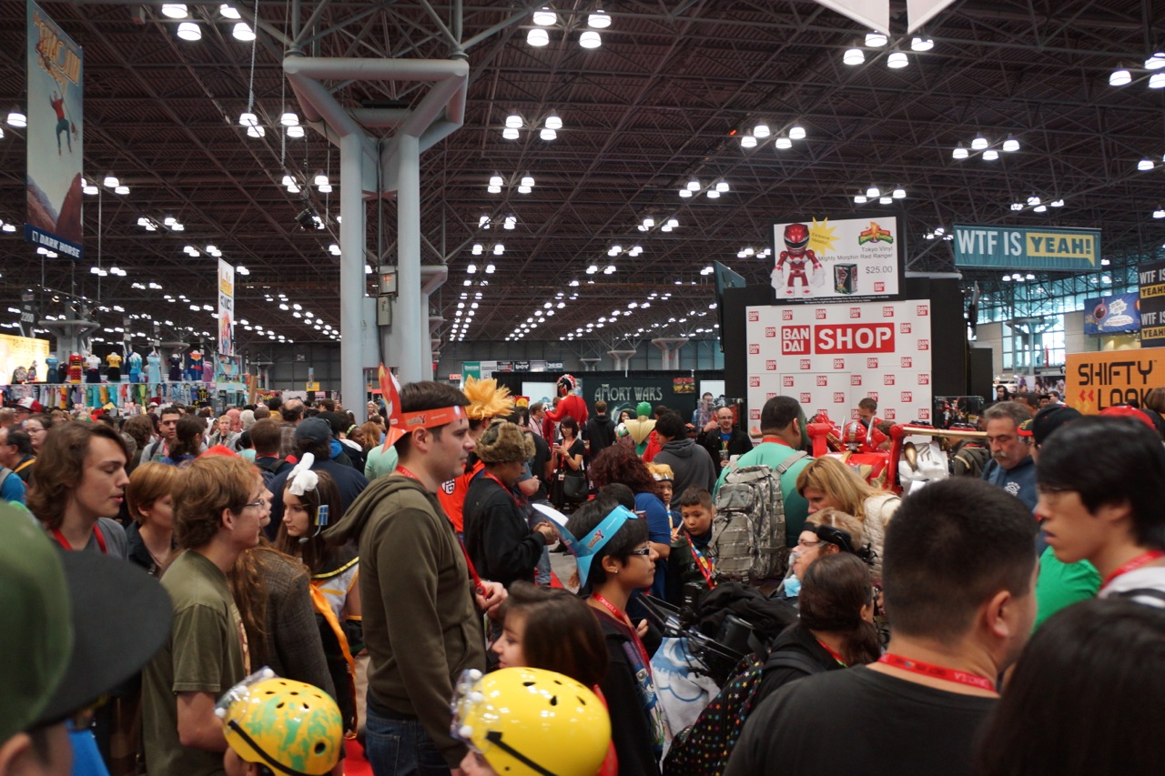
Date #2 : Comic-Con Conundrum

Slide 33
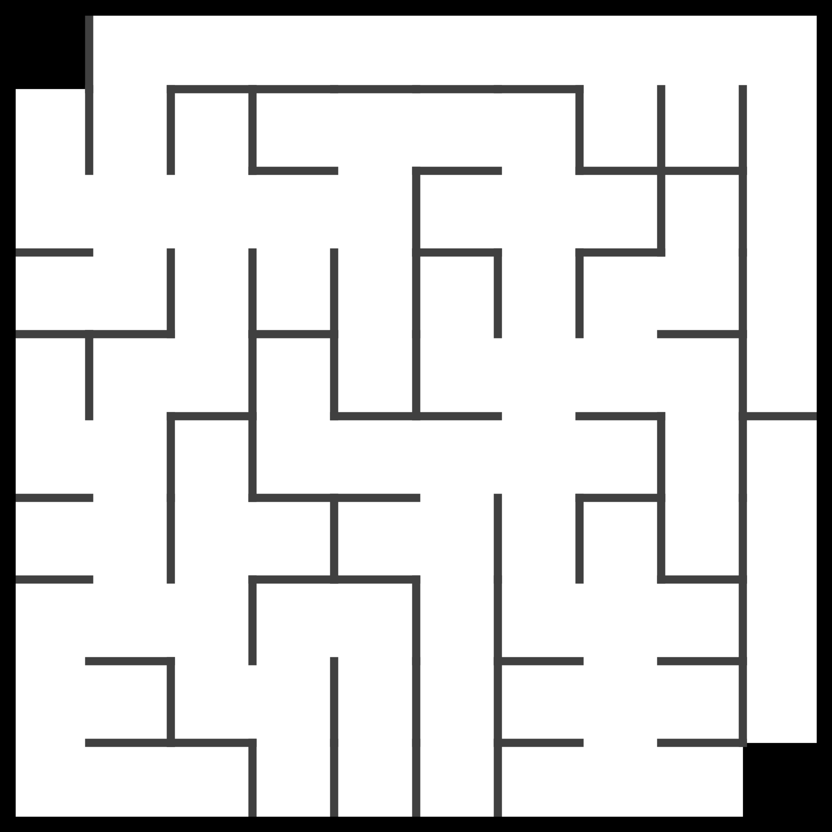
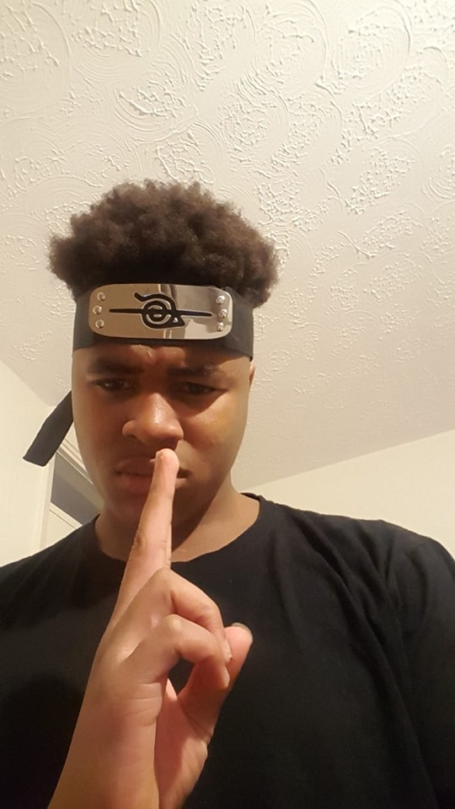
You
How to play:
Get to the end of the maze to reach Taku by using the controls on the right of the maze.
However it’s not that easy, various challenges will arise at different corners of the maze so be prepared. Taku awaits you

Slide 34
You

Slide 35
You

Slide 36
You

Slide 37
You

Slide 38
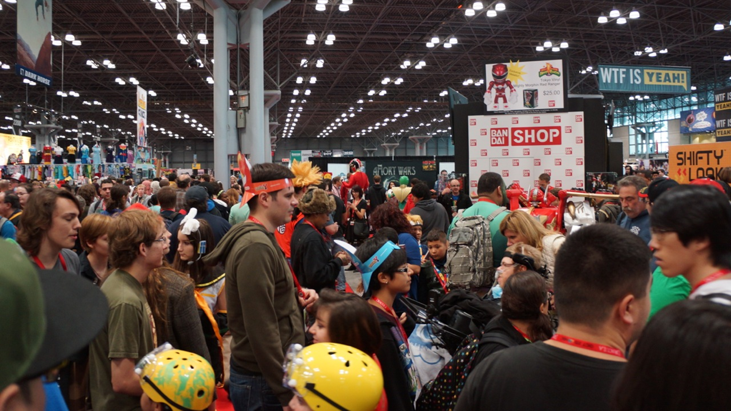

Turn around
Now
You don’t question him.
Run

Slide 39
You

Slide 40
You

Slide 41
You

Slide 42
You

Slide 43
You

Slide 44
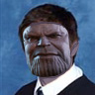
M̴̱̖͖͗̈́̍̍̐ǎ̵̢̺͖̄̓̃̉̿y̷̝̏ ̸̣̗̯͔̐͒͑̽͘͜ḯ̵̧̙͚̫̘̦̇̄͝ ̶̦̞̽̿̅i̶̪͖̽̽͗͆̓͠n̵̨͎̲̬̾t̵̙̥͙̳͙͛ȓ̵̨̢͔͚̮̼̳̈o̷̡̞͎͖̰͖̰͛̿̊̅͊̍͝d̶̮̱͎̗̼̤̫͊̌̉́̉ư̴̛͈̺̬̏̽̈́͂c̷̗̩̯̲̰̈́̇̂̋̓͠ë̶̛̼͈̮͎͍̮́̏̐̈́͠ ̶̡͇͚͔̩̘̑̑̿y̷̛̬̠̣͈͉͎͂̈̎͘ͅo̶̙̟̅̍̉̾͛͑̚ŭ̷̥̻̾ ̸̭̟̠͑́̉̈ͅt̶̎ͅo̴̟̣͇̦̗̩̎́̀ ̶̡̙͈̹̆̌̎̔̃͌͂m̴̢̪̗͉̼̣͉̐̽̌̑̍̾͘ỵ̶͚̇́̾͝ ̵̱̜̺͐͐͂͝r̵̺̝̥͓̞̻̟̓̑͝͠ë̵̢͉̞l̷̗̰̗͕͙͓̒̿̀̑̚̚i̴̮͍̙̗̎̋̓͝g̵̗̳̼͂͒͛͗i̴̮̪̗͑̓͆̅̒ͅỏ̷̡͈̬̹̲̈́̓͗̆͘͝n̴͙̰̳͉͂̌̐̀̐̕͘͜
Go back
…Go on

Slide 45
"I know what it's like to lose. To feel so desperately that you're right, yet to fail nonetheless. It's frightening. Turns the legs to jelly. I ask you, to what end? Dread it. Run from it. Destiny arrives all the same. And now, it's here. Or should I say, I am."
“Titan was like most planets. Too many mouths, not enough to go around. And when we faced extinction, I offered a solution. Genocide. "But at random, dispassionate, fair to rich and poor alike. They called me a madman, and what I predicted came to pass. "With all six stones, I could simply snap my fingers. They would all cease to exist. I call that... mercy. “Then, I finally rest. And watch the sun rise on a grateful universe. The hardest choices require the strongest wills."
I’m sorry little one
For I must go

Slide 46
You

Slide 47
You

Slide 48
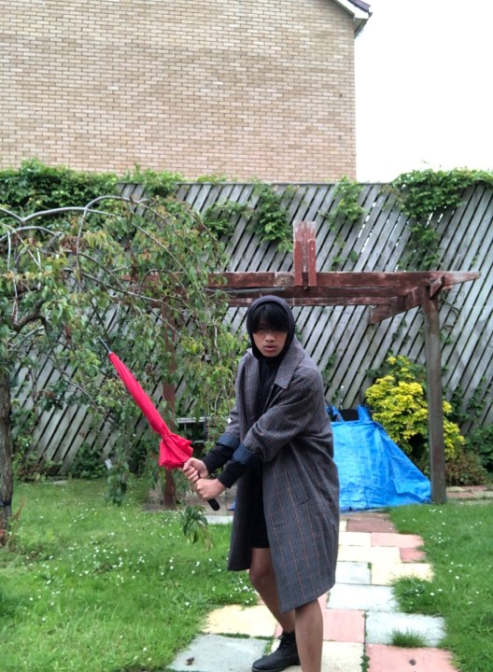
Uh oh – he’s back and he doesn’t seem too happy about how your last ‘conversation’ went
(•ˋ _ ˊ•)
Remind him of how dressing up as a samurai is not only a spit in the face to the Japanese culture, but also romanticising the horrific history behind Japan. Arguably, Japan was worse than Germany in WW2 due to their occupation of China. Significant war crimes like the massacre of Nanjing and the treatment of prisoners of war. Approximately 20 million Chinese civilians died in the fighting due to Japanese savagery, and yet you dress up like this ignorant of what history you are portraying.
His stare has went from filled with passion yesterday, to burning with the rage of a thousand suns. How are you going to deal with this?
(╬ Ò ‸ Ó)
*respectfully bow*

Slide 49
( ͡°⁄ ⁄ ͜⁄ ⁄ʖ⁄ ⁄ ͡°)
He blushes a little after your gesture of respect. He moves out of your way and allows you to carry on with your quest for Taku
You feel like you’ve made a new friend now, he may be a little like your little brother but a friend nonetheless.
Carry on

Slide 50


Slide 51
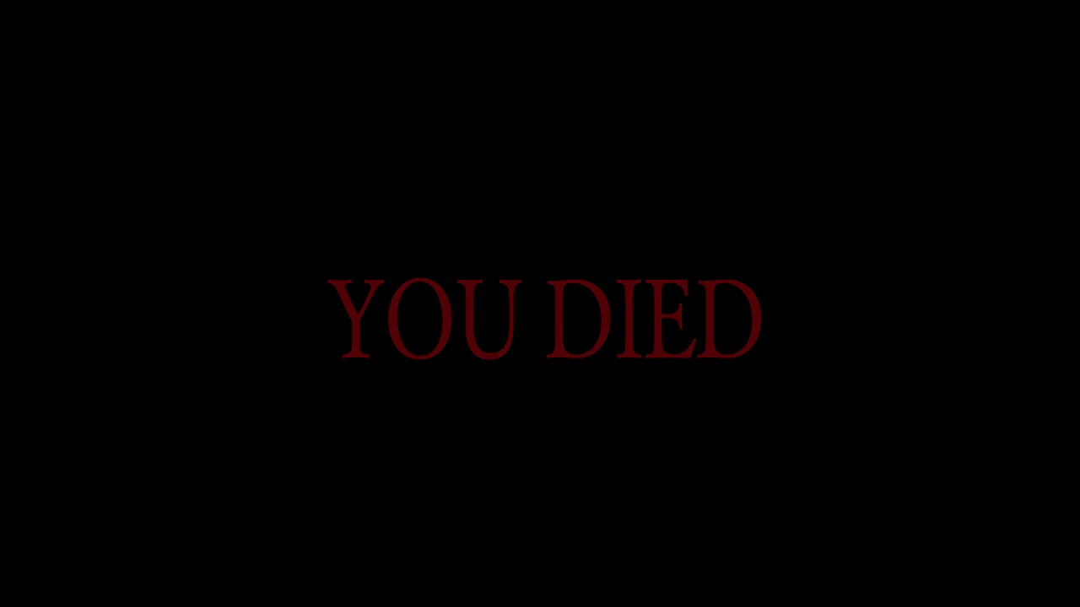
He took that as an act of aggression
Next time, think before you perform your facial expression
Try again

Slide 52

(╥﹏╥)
Him and your little brother start uncontrollably crying. As your little brother starts bawling out loud, people around you start staring and pointing at you.
Your little brother starts a tantrum, holds onto your leg and screams more loudly. Afraid your going to make a scene, you make your way out of the centre.
I'm not even going to give you a fail screen that was just uncalled for. You really need to work on your people skills dude.
Try again
But seriously what the hell

Slide 53
You

Slide 54
You

Slide 55
You

Slide 56
You

Slide 57
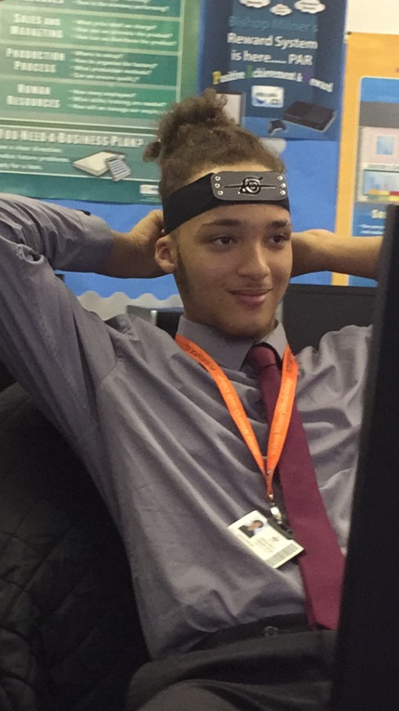
Is that your child?
This man looks more civilised than a typical neckbeard, but he asks a weird question:
You wait for a few seconds to see if he was joking or not, but he does not retract his question.
No
Yes
What do you say?
Depends on how much you got

Slide 58
How much?
Bruh.
Your little brother looks up towards you not really sure what's happening, but gets creeped out at the wild grin you have
Not for sale.
You can have him for free if you want.
What’s your response
Depends on how much you got.

Slide 59
I’ll give you 3 pounds and this headband for him, I beg.
Perfect. This would at least make the date a bit less awkward if your little brother isn’t there.
Clink grips your hand a bit tighter, but your mind has already been made up
Deal
That’s not enough mate cmon
No sorry he’s not up for sale

Slide 60
Aight, what about 3 pounds, this headband, AND my oyster card.
Perfect. This would at least make the date a bit less awkward if your little brother isn’t there.
Clink grips your hand a bit tighter, but your mind has already been made up.
Deal
Higher.
No sorry he’s not up for sale

Slide 61
Hehehe
You hand over your little brother to this mysterious man. You feel a little guilt, but who wouldn’t sacrifice everything for time with Taku.
As you start to walk back into the maze, you hear the man scream in pain. Startled, you turn around to see little Clink with his jaw clenched around the man’s ankle he tries to shake him off frantically.
Disappointed, you trudge your way back to the man and release him of Clink’s vice like grip around his leg. Looks like your stuck with him
Carry on

Slide 62
Cmon man just try it
Go back

Slide 63
You

Slide 64
You

Slide 65
You

Slide 66
You

Slide 67
Surprised how u found me in here with all these people fam. Is that ur lil bro?
You finally made it to the one and only. You slowly slide your little brother behind you out of sight so you and Taku could have the date you’ve always dreamed of.
You and Taku both walk off into the various stalls to go look at the merch and to take pictures with cosplayers.
Halfway through the date, Taku reaches for your hand and holds it affectionately. You wished this moment would last forever as you grip his impossibly soft hand.
Melt inside

Slide 68
…And that’s basically how I became president of Zimbabwe. Yo, didn’t you come here with ur lil bro or something?
Hours pass but it seemed like seconds when you’re with him. You not even paying attention to what he’s saying, just his mere presence alone makes you content with just about everything in life.
You snapped out of your love daze and panic started to set in. Fearing the worst, you slip out of Taku’s hand and start looking left and right praying that Clink is around somewhere.
“CLINK? WHERE ARE YOU?”
He’s no where to be seen. You feel the dread start to envelop you as your hope of finding him becomes smaller and smaller. What do you do?
Ask the people around you if they’ve seen him
Taku>>>Clink. You can make more Clinks later if ygm

Slide 69
I get that I made you sell him earlier…
But I’m not that evil to make you do it again
Try again

Slide 70
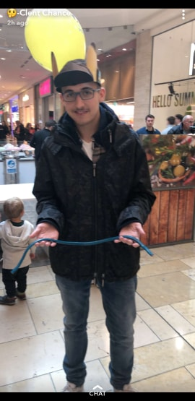
Warg1 peng ting. No one has ever denied me, especially to my face, except you. Now your gonna learn that your actions have consequences
As you frantically look around for clink, your eyes meet with someone familiar, but when the people start to move away in pure fright your stomach sinks .
Clink was limp but conscious in the mans arms. He kept the same, blank stare towards the ceiling but he didn’t look like he knew what was going on.
Helpless, you just stare in horror as this man turns around and starts running away. Before you even had the chance to weep though, a figure flashed before your eyes, as if it was travelling faster than the speed of light.
When you turn around, Taku is no longer by your side, he’s chasing after the man.

Slide 71
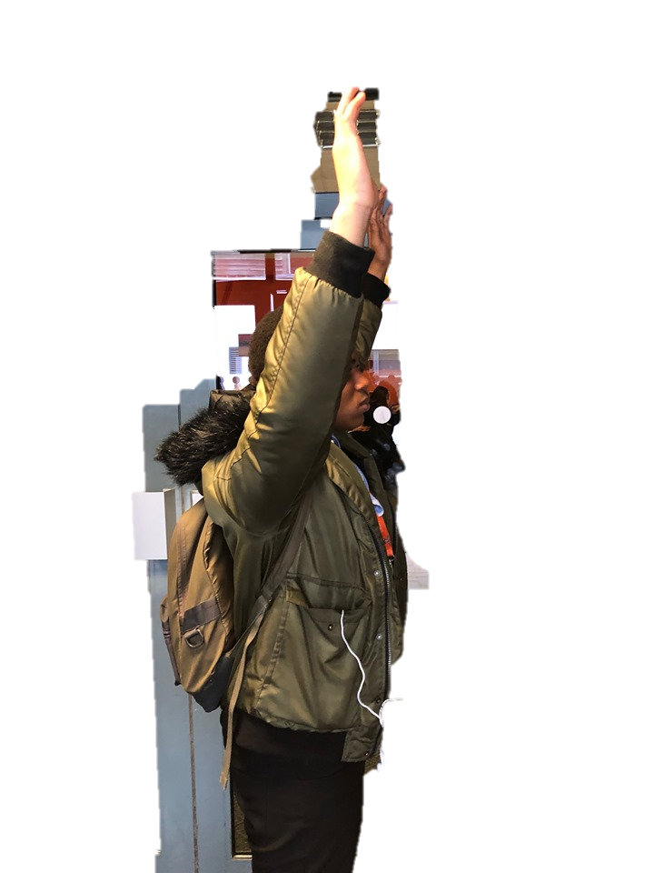
The man stood no chance in escaping Taku’s charge. Before you realised it, Taku had already caught up and jumped to tackle him.

Slide 72
Ay if that wasteman comes back again jus say the word n ill smack that man into tomorrow
You couldn't even muster up a word as Taku walked back to you with Clink as if nothing has happened
You slowly nod your head as you stare in awe and wonder how a man can be so handsome, smart and athletic.
He squats down to Clink and whispers something into his ear. Clink then comes running into your open arms and embraces you for a while.
Head on home

Slide 73
T…Taku said that I-I need to maake sure I Loook after you because you are spe-ci-al
As you start walking home, you start wondering what Taku whispered to Clink after the incident.
When you ask him, he stops in his tracks and says simply:
A tear builds up in your eye as you ponder to yourself what have you done to deserve such a man.

Slide 74
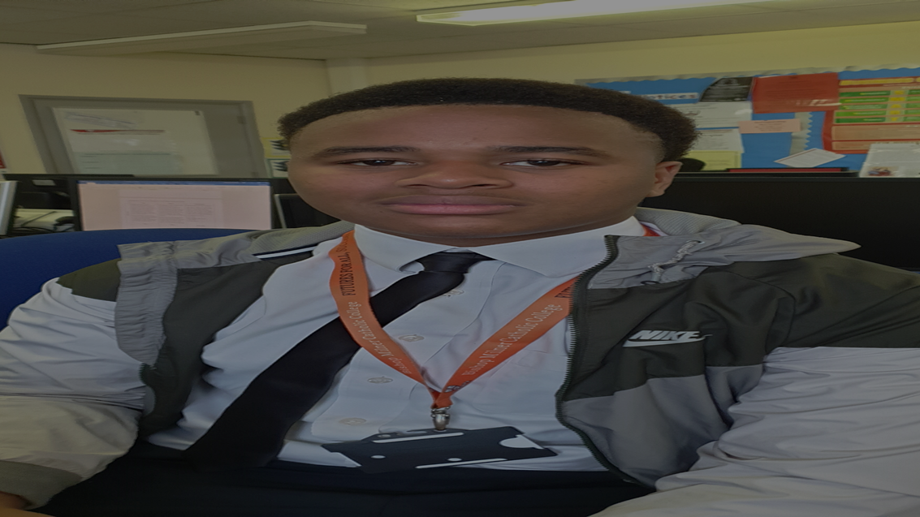
The next day…

Slide 75
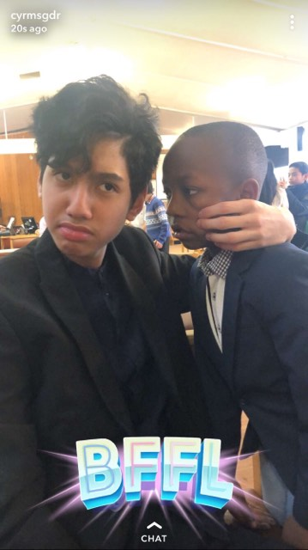
Whilst your alarm was blaring, you woke up from your deep sleep. Groggily, you haul yourself out of your bed and put on your school uniform. You think to yourself how many things you have to catch your friends up with since this has been the most eventful weekend of your life. You come downstairs to find that Clink and his bestfriend Darryl have already prepared and are both ready for school.
You go eat some breakfast, get your backpack and go off to head on your way.
Go to school

Slide 76
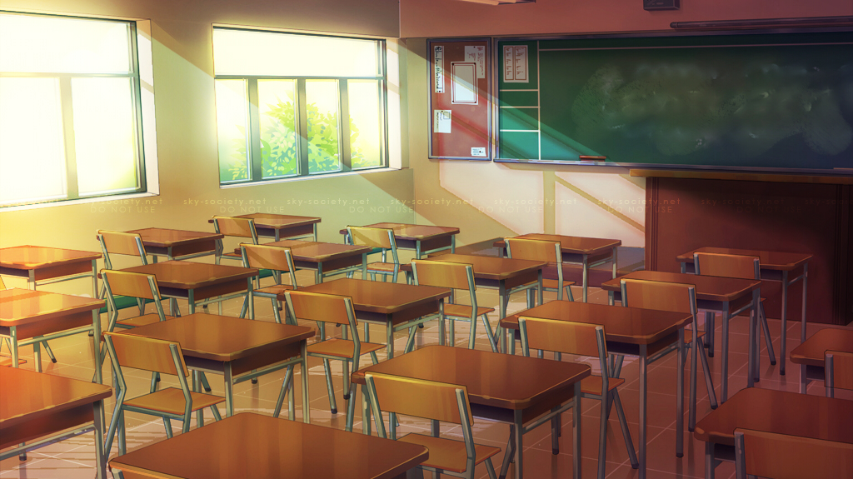
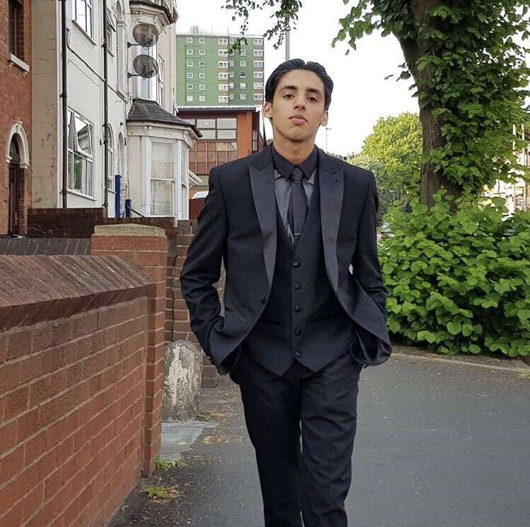
After a long class of math, you pack up your bag and leave your desk. However, before you leave a guy in your class steps in your way.
Hey bby I’m Virkdeep Singh, what’s your pretty self doing here all alone ;)
You blush a little at his swagger and style, plus his pick up line sounded too good to be made up on the spot. This guy has skills
Nice to meet you Virkdeep
I’m just trying to leave class could you get out of my way
Hey if I’m pretty and you’re cute, we’d be prettycute together;)
What do you say?

Slide 77
Sorry if im bothering you, you just looked a little down, is there something that’s worrying you?
Sometimes its better to talk about them out loud then bottle it up, y’know.
You decide not to answer truthfully since way too much is going through your mind.
You smile a little to his advice. He seems like a nice guy so you decide to trust him for now.

Slide 78
So, do you like math?
Same here, I find it so boring since the only number I want to know is yours ;)
“Not really” you reply.
Hot damn.
Batter eyelids
You try to hide your blush from him but Virkdeep already knows that he’s got you under his spell.
Blow a kiss
“You’re sweeter than 3.14”
What next?

Slide 79
You mind if I walk you home sugar? ;)
Whilst chatting to the smooth talker the bell rings signalling the end of the day.
That’s fine by me ;) I’ve always been wondering if you got all the looks in your family ;)
Despite the “romance” you and Taku had over the weekend, You reluctantly agree to his request, but remind him that you have to go pick up your little brother first.
You blush a little, then go off to pick up little Clink.

Slide 80
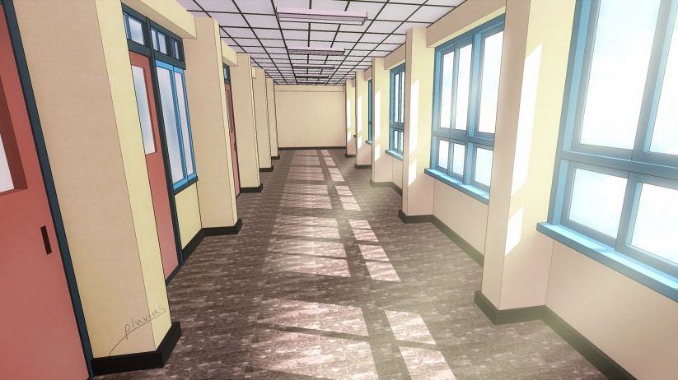
You and Virkdeep make up some small talk while you go to Clink’s nursery class to pick him and Darryl up. Virkdeep asks why Clink is still in nursery at his big age but even the doctors are stumped on that.
I guess cuteness doesn’t run in the family ;)
As you walked down the stairs and into the parking lot of the school to start walking home, Clink suddenly started mumbling under his breath
And sure enough he was there, not looking too happy too after seeing you walking with Virkdeep
He usually does this, but this time it sort of sounded like he was chanting “Taku…Taku…”
Uh oh

Slide 81
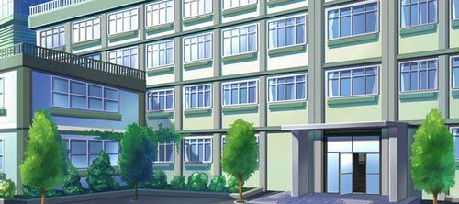
Date #3 : School Survival

Slide 82
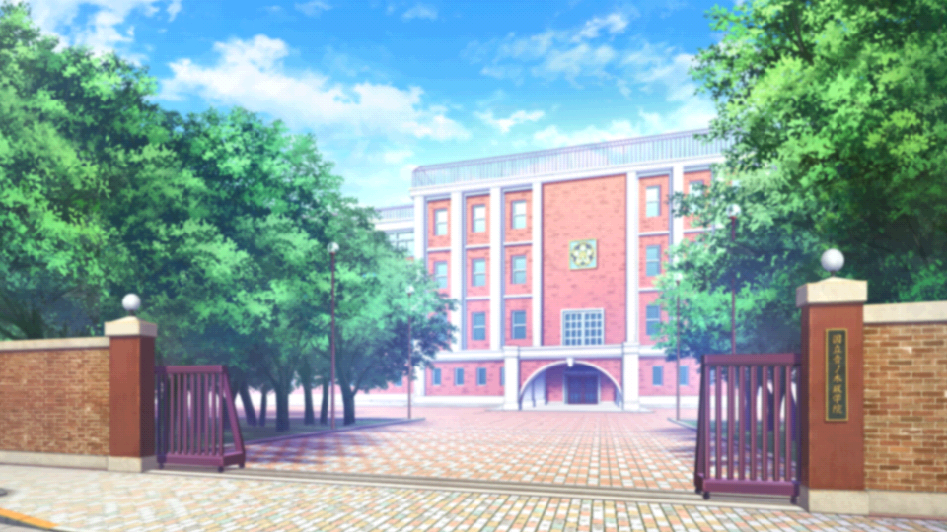
How to play:
Choose all the correct choices that make Taku calm down from his passionate rage.
Right choices will empty out his rage bar however wrong choices will make it rise.
Taku is a force to be reckoned with, so be wary.
100% RAGE

Slide 83
What the hell are you doing being with this fool fam
100% RAGE
It-It’s not what it looks like
He’s just a friend I’m walking home with

Slide 84
You think this is a joke *****, I ain’t never put my feelings out like this for NO ONE. Leave.
110% RAGE

Slide 85
I’d understand if after being lectured by Taku like that you’d want to take a break…
But Taku can still be tamed. Be strong.
Try again

Slide 86
I thought we had something…
80% RAGE
We do I swear
You haven’t even invited me to your trap house.

Slide 87
We sipped lean together…
60% RAGE
Bro that’s just a regular Saturday for me
And we still can if you give me a chance

Slide 88
I let you comb my hair…
40% RAGE
(You need to put some oil in that still)
Your hair is better than his anyway

Slide 89
Naw that was a bit too rude still💀💀
Get back in there champ.
Try again

Slide 90
R U still my ride or die
20% RAGE
Die is a bit too far
Forever

Slide 91
Sorry…I don’t know what came over me
What you looking at fam
Taku seems like he’s calmed down from his uncontrollable rage. He unclenches his fists and starts to breathe more lightly.
Square up Dirtdeep
However, Virkdeep still stood close to you, staring down Taku with no sense of fear when returned with Taku’s frightening glare.
“Btec Terry Crews” Virkdeep replied snarkily. You can feel the tension in the air thicken as you slowly back away with Clink hiding behind your legs.
Battle

Slide 92
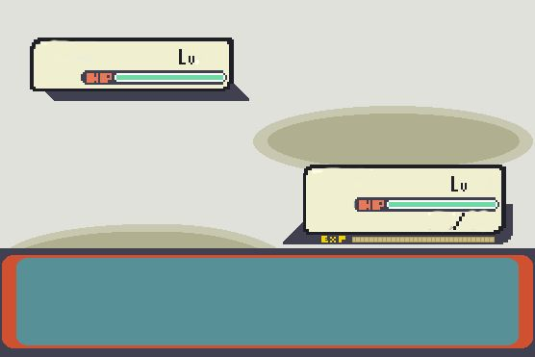
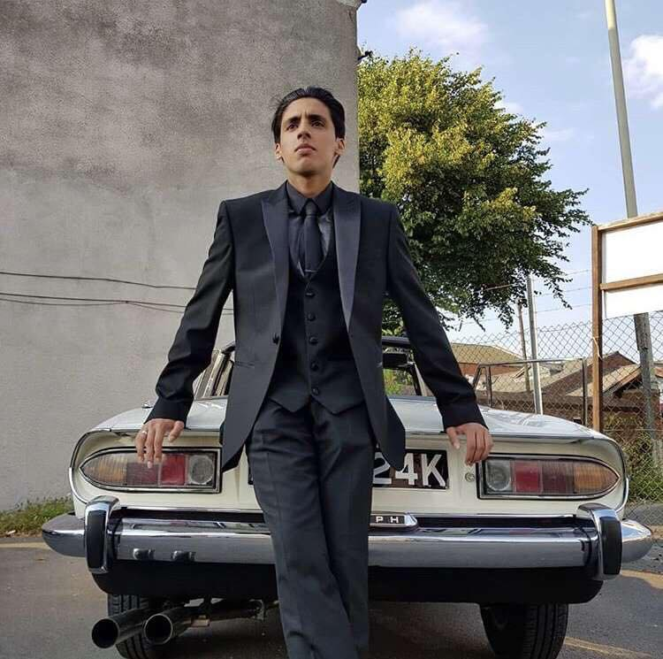





Slide 93
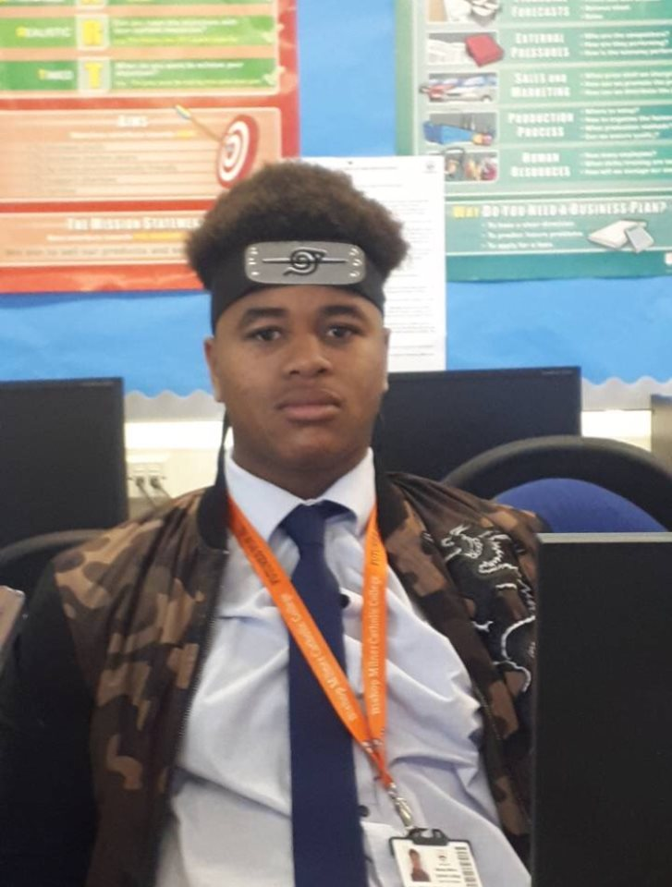


Slide 94



Slide 95




Slide 96
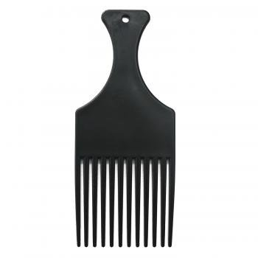

Slide 97
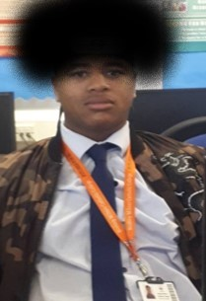

Slide 98


Slide 99
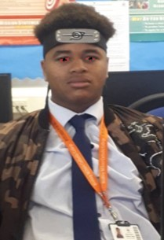

Slide 100




Slide 101
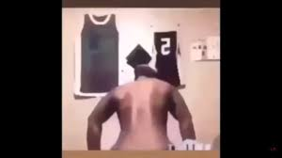


Slide 102
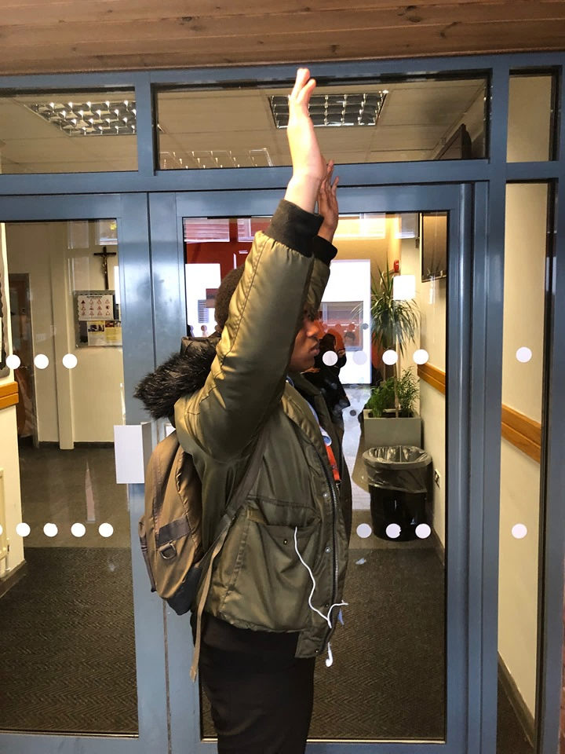

Slide 103


Slide 104


Slide 110


Slide 111



Slide 112




